Slide 1
Sandworm Attack Variation on Windows System
Date: 3/20
Member: 陳星宇
Advisor: 謝續平 教授
Notes:
為何要以sandworm為研究對象? 因為他是Mitre在2022選出最有影響的組織之一，希望這個研究能夠讓研究者和企業更加了解如何防範類似的攻擊。 為何要做variation? 想找到規避防毒軟體的方式、看variation後的攻擊成效，提供防毒軟體的製造商其他方向來保護主機。

Slide 2
Outline
Introduction
Attack Reconstruction
Original attack
Analysis
Motivation and Purpose
Variation
Steps
Details
Result
Analysis
Conclusion

Slide 3
Introduction
Attack Reconstruction
Automation script
Analysis
Behavior
Log
Variations
Notes:
在研究完Sandworm attack chain之後，我們完成了自動化腳本、分析system log並找到一些我們覺得比較異常的log，也對原本的攻擊步驟提出了一些想法及討論。
因此我們決定針對原本攻擊手法的一些不足之處做variation，希望可以隱藏一些異常的log並規避防毒軟體的偵測。
最後，我們研究做出的貢獻是完成了automation script and variations on setting the persistence

Slide 4
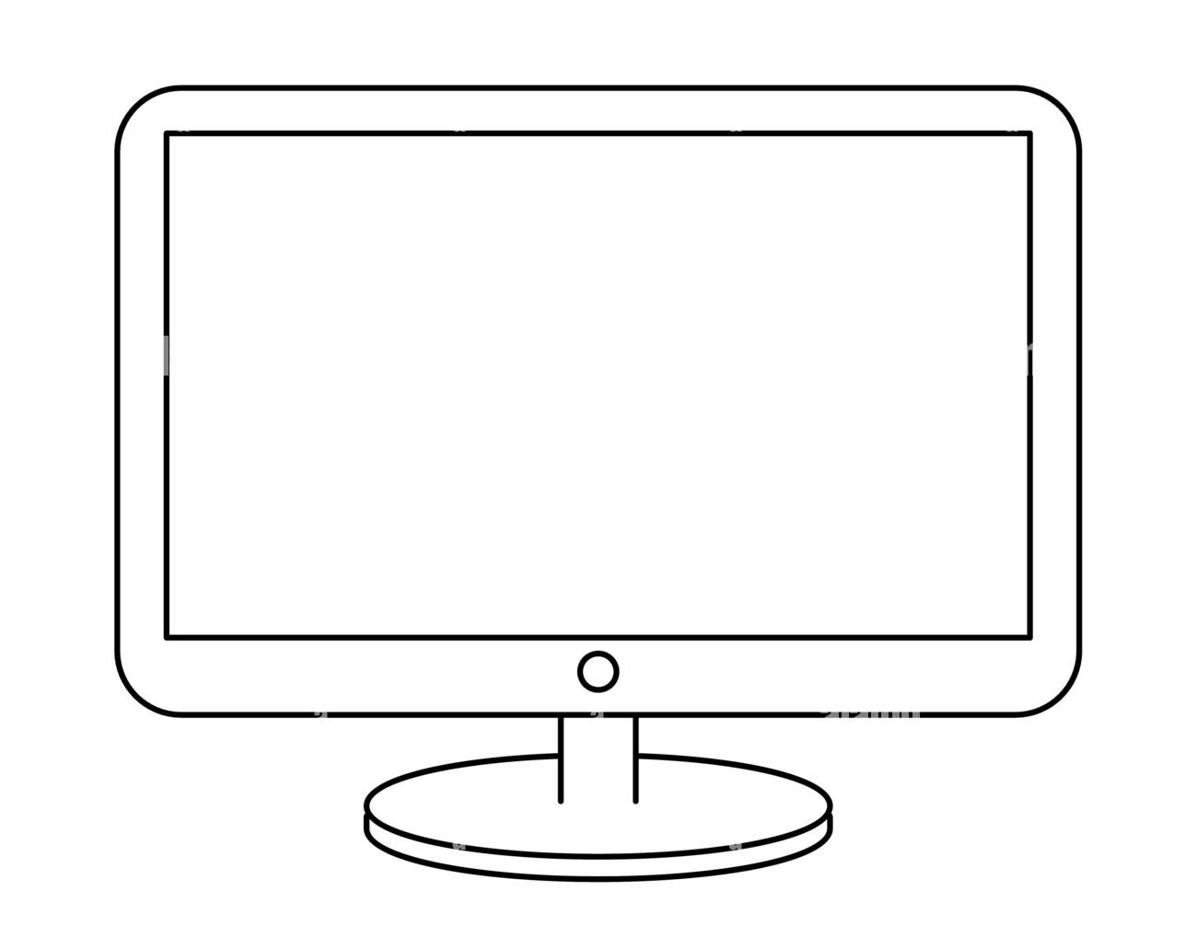
Attack Topology
1
Set persistence with 0-day exploit
10.0.1.4
2
Send credential back to control server
Linux victim
192.168.0.4
Set persistence with RDP
3
Get DC credential with keylogger
10.0.1.7
4
Deploy Notpetya
Windows victim
5
Attacker
10.0.1.8
Domain Controller
Notes:
因為攻擊windows這台主機的步驟較多，包含透過registry set persistence、建立C2 channel以及使用keylogger等工具竊取資料，我們認為有比較多variation的空間，因此最後選擇做windows這台的variation

Slide 5
Original Attack on Windows
Lateral Movement – Lateral Tool Transfer
Transmit the exe downloader through samba
Persistence – Modify Registry
Save the command to execute the downloader as value into registry hive
Defense Evasion – System Binary Proxy Execution: Rundll32
The downloader will download the dropper upon logon
Execute the dropper
Exfiltration – Exfiltration Over C2 Channel
The attacker retrieves system information as well as credentials via the C2 channel

Slide 6
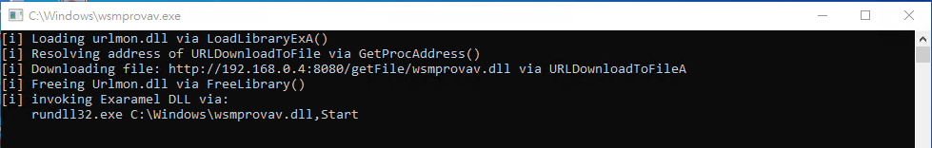
Observation
Behavior: As the downloader is executed by registry upon logon, a cmd window will pop-up.
Suspicious Log
Source of the backdoor
Backdoor Invocation

Slide 7
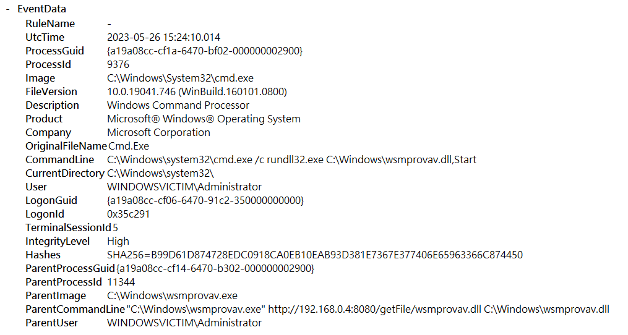
Log Analysis – Source of the Backdoor
We can observe that the backdoor is downloaded from a suspicious IP. We can infer that attacker inject this persistence from the attacker’s IP.
Notes:
因為這個IP是來自外網且不是具公信力的IP

Slide 8
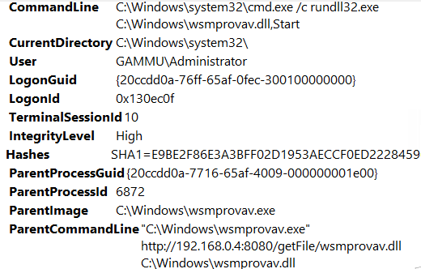
Log Analysis – Backdoor Invocation
After the downloader fetch the backdoor, it invokes cmd to execute the backdoor. As cmd.exe is invoked by an unknown program, it is a highly suspicious behavior[1].
[1] MITRE ATT&CK - Processes spawning cmd.exe
Notes:
cmd的parent process在一般情況下是由explorer.exe開啟的，除非是automated script，而wsmprovav.exe是在這個環境下不知名的程式，所以很容易被視為是一種異常狀況。

Slide 9
Motivation and Purpose
After performing analysis, we’ve raised three questions:
Is there a way to get rid of the cmd pop-up upon logon?
Is there a way to avoid using the attacker IP directly in the command?
Cmd invoked by unknown process is considered abnormal, can we avoid invoking the cmd to execute our backdoor?
To tackle the problem, we’ve done some research and experiments.
Notes:
原本的方式是用smb傳送downloader，我們改為dropper。
downloader的好處是可以透過spam email或phishing等social engineering 的方式傳播，但是需要Internet access，而dropper就直接extract出來使用，不需要再從attacker IP要payload.
用dll injection的方式將dropper dll直接以第一個dll啟動(用LoadLibraryA)

Slide 10
Variations - Steps
Defense Evasion – Obfuscated Files or Information: Embedded Payloads
Embed dropper malware into WinSecurity.dll
Lateral Movement – Lateral Tool Transfer
Transmit the dropper (WinSecurity.dll) through samba
Defense Evasion – Masquerading
Copy a new rundll32 into C:\Windows\rundll32.exe[2]
Persistence – Modify Registry
Set “C:\Windows\rundll32 WinSecurity.dll,Start” as registry value
Defense Evasion – Process Injection: DLL Injection
Execute the backdoor within the dropper process with LoadLibraryA
[2] MITRE ATT&CK – Rename System Utilities

Slide 11
Variations - Details
If no signature:
Append worm
2
3
Original
Extractor payload
psexec
Set “rundll32 dropper”
to registry
If has signature:
Extract worm;
Execute with LoadLibraryA;
1
Dropper
Attacker
Victim
Smbclient
Worm payload
Structure of the whole variation attack
Appended payload
Worm starting pos
Worm size
Signature
Structure of dropper
Notes:
口頭敘述dropper的結構

Slide 12
Result – Analysis
Behavior: As the dropper is a dll file, it is executed by rundll32 upon logon, so it won’t show cmd window pop-up.
Log
Set Registry
Backdoor File Creation
Credential Dumper

Slide 13
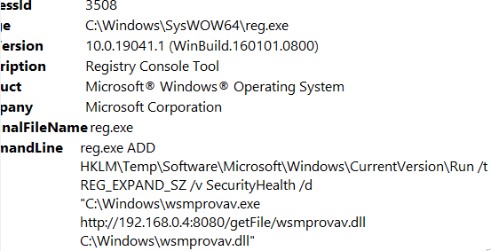
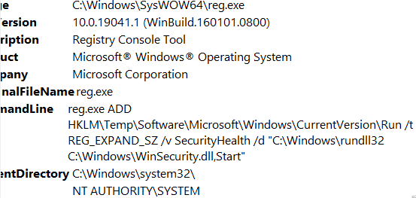
Log Difference – Set Registry
The original one contains attacker IP, which is more likely to be backtracked and identified by the victim, while the varied one doesn’t contain, which cuts the relationship between the backdoor and the attacker IP.
Original contains attacker IP
Variation does not contain attacker IP

Slide 14
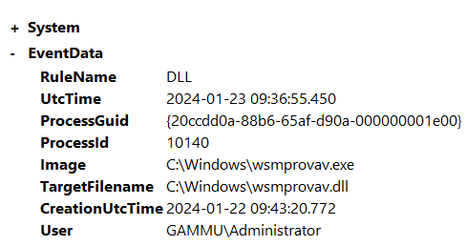
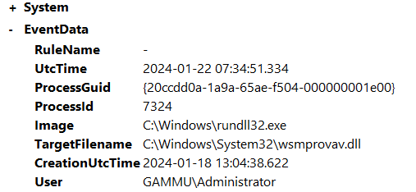
Log Difference – Backdoor File Creation
The original one is created by its downloader, while the varied one is created by its dropper’s caller, WindowsChecker.exe, which is seemingly more secure.[3]
Original created by downloader
Variation created by fake rundll32.exe

Slide 15
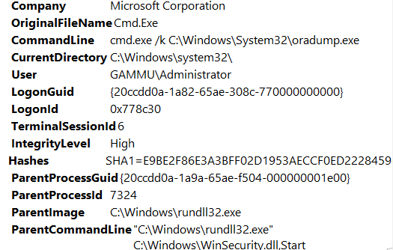
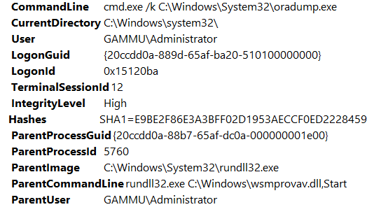
Log Difference – Credential Dumper
In the original one, the dumper is executed by the backdoor, and we already found that the backdoor was downloaded by a suspicious IP, which in chain raise the possibility of being detected.
In the varied one, the dumper is executed by the dropper through LoadLibraryA directly, and it’s not that obvious to know the dropper is a malware.
Original executed by rundll32.exe
Variation executed by fake rundll32.exe

Slide 16
Conclusion
After replaced some of the steps, there are less suspicious log, including:
The elimination of the relationship between malware and attacker IP.
The elimination of cmd pop-up window.
Removing the usage of rundll32.exe.
Possible research in the future: Replace other techniques in the Sandworm attack chain, including protocols, file transmission or design a new way to identify those variations.

